Slide 1


EARLY CHILDHOOD EDUCATION RESEARCH AND CONTEXTUAL POLICY ACTION
Prof. Anies Al-Hroub
Educational Psychology & Special Ed.
American University of Beirut
Arab Resources Collective/MAWARD
Email: aa111@aub.edu.lb

Slide 2





Introduction
Shapes the foundation for lifelong learning.
Early Childhood Education
Vital for individual child development.
Vital for socio-economic advancement of communities and nations.
Lays the groundwork for skills:
Cognitive
Social
Emotional
Despite its importance, many Arab countries face significant challenges when it comes to quality ECE and policy.
Notes:
By examining the existing data, we can better understand the gaps in ECD provision and explore effective strategies to enhance educational outcomes for young children in the Arab world.

Slide 3

Table of Content:
Overview of ECE research in the Arab region.
Research and Policy.
Future Prospects and Recommendation.

Slide 4

Research Overview

Slide 5



International Collaboration and Research Efforts
Research efforts across the Arab region have involved collaborations with international bodies such as:
UNESCO, UNICEF, World Bank.
Such collaborations have provided frameworks for evaluating ECE and helped introduce reforms aimed at aligning national policies with international standards​​.
Conferences, such as the Arab Regional Conference on Early Childhood Care and Education, have provided platforms for policymakers and researchers to discuss strategies for improving ECE, exchanging knowledge, and emphasizing the need for capacity-building in the region​.

Slide 6
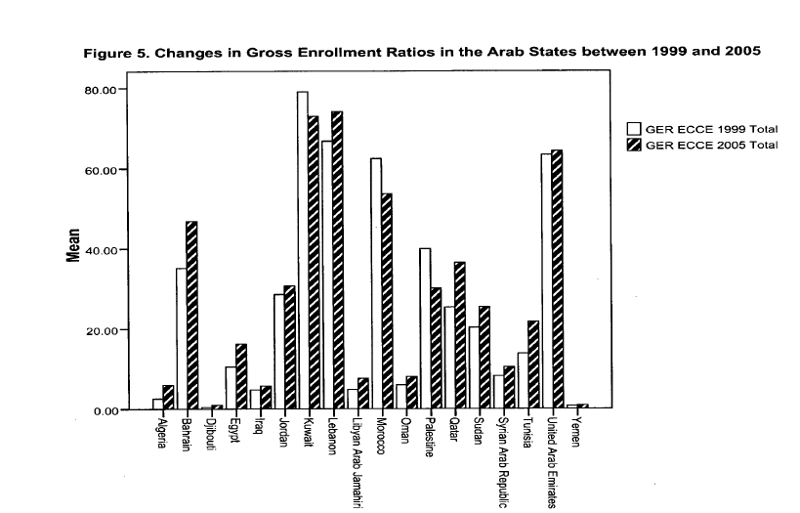

Enrolment Rates:
Lebanon had the highest percentage ~ 75%.
However, it was revealed that the higher attendance was among wealthier families, while enrollment among the lowest socio-economic quintiles, including displaced and refugee children, remains significantly lower.
The gross enrollment ratio (GER) for pre-primary education in the Arab states was around 16% in 2004.
By 2016, the GER remains relatively low, with significant variations between countries. The average rates are approximately 27% for children aged 3-4 years and 24% for children aged 5-6 years (Shehadeh, 2008; MEHE, 2021).

Slide 7
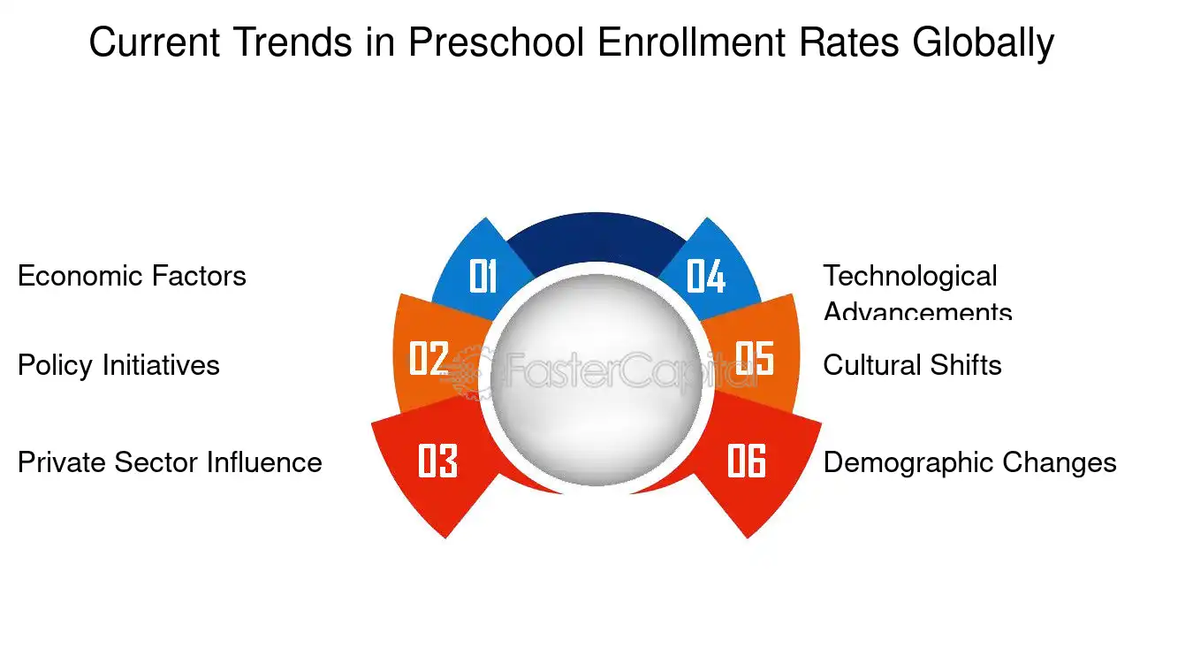
International Collaboration and Research Efforts

Slide 8
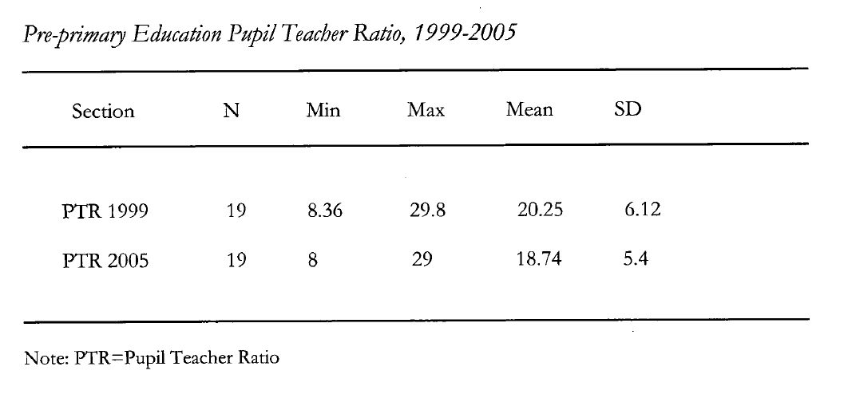
Quality of Teaching Staff and Facilities
High pupil-teacher ratios (PTR) Low quality in pre-primary ed.
High PTR in Palestine 26:1.
High in Algeria & Syria ~ 29: 1.
High PTR in Saudi, Sudan, Algeria, Egypt.
Indicating insufficient teacher availability around 2005
Better PTR ranges: 15:1 in Bahrain
18:1 in Qatar.
By 2020, there has been a rapid expansion of the kindergarten sector namely in Saudi Arabia. The rapid expansion strained the availability of qualified staff. → a shortage of qualified kindergarten teachers in Saudi Arabia (Al Shanawani, 2023).

Slide 9




Quality of Teaching Staff and Facilities
Morocco
and other countries
shortage of trained teachers in rural areas
ECD centers understaffed or staffed with underqualified personnel.
Public programs fail to provide sufficient training and professional development opportunities
A lack of standard curriculum or national training requirement for ECE educators, leads to inconsistent quality of education (Shehadeh, 2008).

Slide 10
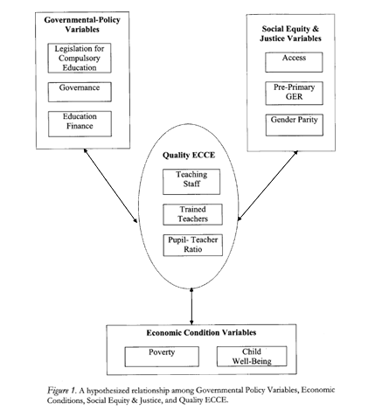

Impact of Socio-Economic Factors
Children from lower-income families are less likely to enroll in quality pre-primary programs.
Provided by the private sector
Lack of proper government investment in ECE.
Lack of legislation for compulsory pre-primary education
Disparities in access based on economic status.

Slide 11



Absence of Public Sector Engagement and Overreliance on Private Provision
In several Arab countries, ECE services are largely left to the private sector.
In Jordan and Tunisia for example,
research shows that private ECE providers cater
mainly to wealthier (upper- and middle class) families,
leaving lower-income with no access to quality ECE.
This deepens socio-economic inequalities and limits opportunities for disadvantaged children (Shehadeh, 2008).

Slide 12

Governmental Funding and Support
Saudi Arabia faces challenges related to insufficient government funding for ECE programs, especially in rural areas, leading to uneven access and quality between areas (Shehadeh, 2008).
Egypt’s policies and financial support were insufficient, leaving many early childhood programs underfunded and reliant on private or informal sectors​. (نصار، 2014)
Lebanon’s ECE programs have historically relied on private funding. Public sector ECE programs are often underfunded, resulting in limited access for disadvantaged populations, particularly during political & economic crises​ (MEHE, 2021).

Slide 13

Governmental Funding and Support:
Jordan
and other countries
Significant ECE services underfunded
Public sector involvement is weak
Resources are concentrated in urban areas
The integration of refugee children into the national ECE system: slow due to economic constraints (UNICEF, 2023).
The government has struggled to provide the necessary resources to expand public ECE services.
(OECD, 2020; Shehadeh, 2008)

Slide 14


Regional Disparities
In Morocco, rural regions face significant challenges in ECD access.
Lack of public infrastructure.
Urban areas benefit from better-funded private ECD services (UNICEF, 2023).
In Tunisia gaps persist in terms of the quality of services available (UNICEF, 2023).
A 2015 UNICEF study found that children from rural areas, were still less likely to receive high-quality early education.
14

Slide 15




Regional Disparities
In Jordan and Lebanon, the situation is complicated by the presence of a large refugee population.
ECD programs, often fail to meet the needs of refugee children due to overcrowded classrooms and underfunded public initiatives.
The inequitable distribution of resources between host communities and refugee settlements highlights a critical issue in the region, where policy implementation struggles to meet the demands of the most vulnerable populations.
15

Slide 16
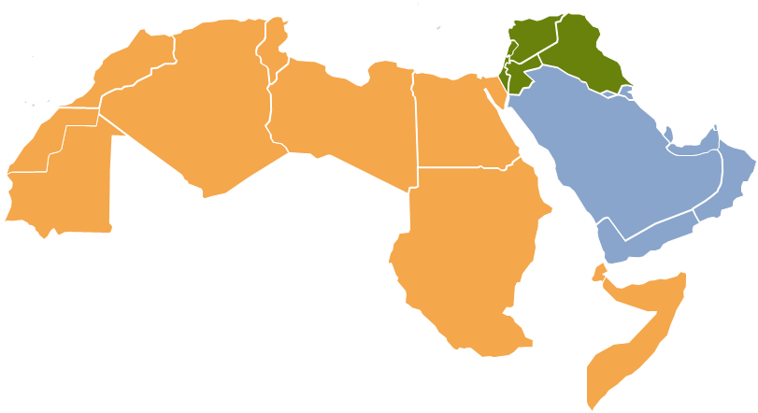
Lack of Unified Standards:
Data stresses the absence of standardized policies and guidelines across Arab countries to ensure the consistent development of ECD programs. This results in fragmented efforts and varying levels of service quality from one country to another ​(ESCWA, 2016).

Slide 17
Research & Policy

Slide 18
Policy Initiatives and Research Developments
  In Saudi Arabia:
  - Investment to improve ECE in their 2030 Vision.
  Focus on increasing access to ECE for disadvantaged areas.
  Focus on improving teacher training and quality assurance.
  Gaps: inadequate teacher preparation, inconsistent
  standards, uneven access across rural and urban areas.
  (Al Shanawani, 2023)
  In Lebanon:
  Acknowledge the importance of ECE.
  Priorities for expanding ECE enrolment, particularly among vulnerable groups
  Gaps due to economic
  instability and ongoing crises (MEHE, 2021).
  In Egypt:
  Policy on ECE has been shaped by the international Education for All initiative.
  Strong emphasis on policy reform.
  Gaps: vulnerable populations access to ECE, better
  governance and funding allocation, domestic barriers
  like high fees and inadequate funding(نصار، 2014) ​.

Slide 19


Implications of Increasing Gross Enrollment Ratio (GERs)
The rise in GERs in ECE across the Arab states, from 16% in 2004 to ~ 27% in 2016
Positive trend in acknowledging the importance of early childhood education.
However, the uneven increase across different socioeconomic groups highlights significant policy gaps (Shehadeh, 2008):
Uneven Distribution
Lack of Legislation
Resource Allocation
  Funding is not uniformly distributed across regions or demographics.
Lack of compulsory ECE policies is a significant barrier that hinders the spread of ECE.
(Kotrane, 2022).
Lack of strategies aiming to provide equal access to quality ECE, regardless of economic background.

Slide 20

Implications of Pupil-Teacher Ratios
Compromised Learning Outcomes
High PTR:
Decreased Individual Attention
Increased Stress on Teachers
Lack of training programs that can equip teachers with the skills to manage larger classes more effectively, employ differentiated instruction, & utilize assessment data to better address student needs.
Lack of attractive conditions and incentives hence not retaining skilled educators, which is essential for stabilizing PTRs in regions with teacher shortages.
Lack of educational technology use which can maximize teacher’s reach & effectiveness. Some digital tools can help mitigate some of the negative effects of high PTRs (Shehadeh, 2008).

Slide 21

Implications of Economic Barriers
Lack of Public Funding Prioritization for ECD
Absence of Equitable Resource Allocation Mechanisms
Weak Public Sector Involvement in ECD
Absence of Strategic Planning in Funding Allocation

Slide 22
Implications of Economic Barriers
In Tunisia, while ECE is recognized as an important sector, economic downturns and political changes have repeatedly pushed education reform to the backburner, delaying critical investments.
In Morocco, rural communities face stark disparities in access to ECE programs due to inadequate public investment. A World Bank report indicates that rural areas are often overlooked in national budget allocations, leading to uneven access to quality ECE services (ESCWA, (2016).

Slide 23



Data-Driven Policies and Global Influences
  Research and International Benchmarks:
ECE policies in Arab countries
heavily influenced by international initiatives
Education for All agenda
UNICEF’s (ECD) Index
Research highlighting gaps in access and quality compared to international benchmarks has prompted policymakers to adopt ambitious goals to expand ECE and align with global standards​​​.
For instance, Saudi Arabia’s Vision 2030 explicitly draws from empirical research to expand access to ECE and improve quality​ (Al Shanawani, 2023).

Slide 24




Data-Driven Policies and Global Influences
  Use of Empirical Data in Policy Formulation:
UNESCO
The use of demographic surveys & studies conducted by international bodies has been instrumental in formulating ECE policies.
UNICEF
Reports, such as those focused on the Arab world by UNICEF and the Economic and Social Commission for Western Asia (ESCWA, 2016).
Data showing inequalities in access between rural and urban populations or different socio-economic groups has pushed Arab governments to prioritize vulnerable groups in their national plans​​.
Provide key data on child well-being, disparities in access, and resource allocation, which shape policy directions (ESCWA, 2016). ​

Slide 25


Challenges in Policy Implementation
  Mismatch Between Research and Implementation:
Many countries face challenges in translating these policies into practice.
  Investments in ECE have yet to overcome barriers such as:
  insufficient teacher training
  unequal access to quality programs, particularly in rural areas​​.
  lack of funding and adequate governance mechanisms hinders their effective implementation (Shehadeh, 2008)​.

Slide 26
Challenges in Policy Implementation
  Empirical Evidence on Disparities and Gaps:
Research findings: disparities in access to quality ECE across different regions and populations.
This has led to the development of policies aimed at addressing these gaps.
Limited by
Slow Pace of Reform
Political Instability
Economic Instability
For instance, Lebanon’s five-year education plan incorporates empirical findings on the importance of ECE but struggles with economic and political constraints that hinder its full realization
(MEHE, 2021)​.

Slide 27



Regional and National Policy Adjustments Based on Research
  Influence of Local and Regional Research:
Empirical work conducted by local scholars, as seen in the context of Egypt, underscores the need for policy adjustments that address specific national challenges, such as:
High child poverty rates inadequate teacher qualifications
The research recommends targeted strategies for improving governance, increasing funding, and enhancing teacher training​​.

Slide 28



Regional and National Policy Adjustments Based on Research
  Integration of Research in Policy Discussions:
Regional conferences and collaborations, such as the Arab Regional Conference on Early Childhood Care and Education.
Provide platforms for researchers and policymakers to discuss empirical findings and refine ECE policies.
These gatherings encourage the sharing of research insights that inform policy adjustments.
Although the actual implementation of these discussions remains a challenge (مرتضى، والياس، 2010) ​.

Slide 29


Empirical Research Informing Equity-Focused Policies
  Focus on Equity:
Key Link Between: Research and Policy
Focus on Equity
Research consistently highlights the disparities in access to ECE services based on:
geography
socio-economic status
Gender
This has pushed policymakers to adopt equity-driven reforms. Even though the actual implementation of such policies has been slow, with many countries still grappling with these inequalities(نصار، 2014) ​. (ESCWA, 2016).

Slide 30

Local Research Examples
Morocco
  Significant research
disparity in access to ECE, especially between rural and urban areas.
Initiate
Reforms: aim
to expand rural
ECD programs
This research has pushed the Moroccan government to:
Improve public sector involvement
Programs targeting rural infrastructure and teacher training have been initiated, but the progress remains slow, requiring further policy efforts.
(Kotrane, 2022; MEHE, 2021).

Slide 31


Local Research Examples
Tunisia
Access for rural and economically disadvantaged remained limited
A UNICEF study explored the gaps in ECE enrollment and quality, finding:
Quality of available services was also inconsistent
  As a result of this research, Tunisia has made policy efforts to bridge the equity gap including:
Increasing government funding for public pre-primary education
Implementing teacher training programs in rural areas
However, the challenge of reaching marginalized populations persists, and additional reforms are needed to ensure that ECE programs meet the needs of all children, regardless of socio-economic status
(MEHE, 2021).

Slide 32

Local Research Examples
Jordan
Research has focused on the integration of refugee children into the national ECE system.
In response to this research, Jordanian policymakers have placed efforts to expand access to ECE for refugee children.
However, resource limitations and the scale of the refugee crisis continue to hamper the full implementation of these policies, underscoring the need for sustained international support and strategic resource allocation (MEHE, 2021).

Slide 33
Arab Resources Collective /MAWARD
Projects

Slide 34

The Arab Collective Resources (MAWARD) is a regional coalition that, within the scope of Early Childhood Development (ECD), aims at enhancing ECE through collaborative research, policy advocacy, and direct interventions. The coalition brings together experts, policymakers, and practitioners to address the unique challenges facing early childhood development in the Arab world.

Slide 35


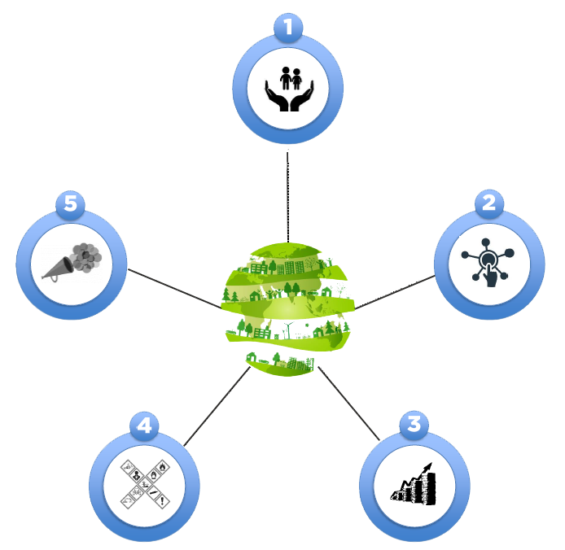
Arab Network for Early Childhood (ANECD)
الشبكة العربية للطفولة المبكرة
Global Trends

Slide 36

Child Protection in Emergencies
Global Trend 1
Children's well-being in conflict zones
+ disaster-impacted areas.
Establishment of safe spaces
GT1 Initiative Focuses On:
Provision of emergency educational services
immediate safety concerns and long-term resilience building.
Psychological support for children facing trauma
Equipping caregivers and local communities with the tools and knowledge needed to protect and empower children during crises

Slide 37

Global Trend 2
Digital Adaptation and Safety
Constructive Use of Digital Tools
Safe Use
of Digital Tools
Digital Literacy
Protecting from Online Exploitation risks
Protecting from cyberbullying risks
Safe Internet Practices
GT2 addresses the challenges and opportunities of the digital age for children.

Slide 38





Global Trend 3
Economic Impact and Social Equity
GT3 focuses on addressing the increasing poverty and its impact on children in the Arab world.
Implement programs that support economically disadvantaged families
Educational Resources
Nutritional Support
Health Care

Slide 39


Global Trend 4
Environmental Hazards and Resilience
Educating Children about Environmental Stewardship
Integrating Climate Resilience into ECD Programs
Focusing on sustainable practices and disaster preparedness
aims to
safeguard children’s health and ensure the continuity of education in the face of environmental crises.

Slide 40
Global Trend 5
Policy and Advocacy
Amplify the Impact of ECD Workers
Advocates through rigorous policy analysis and advocacy training.
GT 5 initiative seeks to influence policy-making and enhance the effectiveness of programs through strategic advocacy efforts, ensuring that the rights and needs of young children are prioritized in public agendas.

Slide 41


Some Findings:
Third Strategic Research Model:
Review of Child Rights Laws & Legislations in the Arab Countries
Lebanon, Jordan, Palestine, Egypt
Concerns about minimum age of marriage being low
Laws permit marriages from 16 years of age or make exceptions.
Policy Implications
Urgent need for legislative reforms to raise the marriage age.
  Engaging religious authorities to support these changes.

Slide 42
Array of Rights Covered
Third Strategic Research Model:
Review of Child Rights Laws and Legislations in the Arab Countries
Right to Participate
Non-discrimination Right
Right to Life, Survival, and Development
Best Interests of the Child
Rights Towards the Family
Freedoms And Civil Rights
Rights Towards the State

Slide 43


The HEPPP Program
One of the first
holistic parenting model
in the Arabic-speaking world
Many parents, particularly in vulnerable communities, face obstacles in providing optimal care due to social, economic, and personal challenges.
Health, Early Learning, and Protection Parenting Program
Implemented across various Arab countries, including Lebanon, Egypt, and Jordan
Assist parents in creating nurturing and responsive environments for healthy child development.
Enhance
parenting
knowledge and
practices.
Integrate
mental health
support for
families.
Strengthen community
-based support systems.

Slide 44
On Effective Collaboration
The HEPPP project demonstrates effective collaboration between government ministries and NGOs.
These partnerships have been largely successful which offers valuable lessons for future collaborations.
Community Engagement
Critical to understanding and meeting the real needs of children and families.
Government Support
Essential for providing legitimacy and resources to the initiatives.
NGO Innovation
Brings creative solutions and close community connections.

Slide 45





The Lebanon-ECD Situational Assessment
Provides a crucial analysis of the impact of multiple crises on ECD in Lebanon. Assesses how the compounded effects of economic collapse, political instability, the COVID-19 pandemic, and the Beirut port explosion have affected young children and their families.
Key Policy Suggestions
Unified National Strategy
Enhanced Social Support Systems
Crisis-Ready Services
Health Awareness and Behavioral Training
45

Slide 46
First Strategic Research Model Brief:
The Status of Parents and Caregivers During Crises in Six Arab Countries:
The Case of COVID-19 Pandemic
Developed by ANECD in 2022, focuses on the profound impacts of the COVID-19 pandemic on parents and caregivers in six Arab countries.
It aims to assess how the crisis has affected child-rearing practices and the well-being of those responsible for the care of young children.
The study highlights significant challenges such as:
Increased psychological stress among caregivers.
Disruptions in educational and health services for children.
Heightened economic strains.

Slide 47
First Strategic Research Model Brief:
The Status of Parents and Caregivers During Crises in Six Arab Countries:
The Case of COVID-19 Pandemic
Based on the findings, the brief recommends:
Enhancing national policies to support families during crises, particularly those affecting health, education, and economic stability.
Developing targeted support programs for the most vulnerable populations, including refugees and low-income families.
Strengthening community and governmental support systems to provide sustainable aid during ongoing and future crises.

Slide 48

Future Prospects and Recommendations
  To address ECD challenges, research consistently recommends increasing government investment in ECE, particularly in teacher training and development, enhancing parental involvement, and fostering better coordination among governmental and non-governmental stakeholders​​.
  There is also a call for integrating ECE into broader national education strategies and ensuring that early childhood development is viewed as a critical component of human capital development, particularly in the context of economic goals like those outlined in Saudi Arabia's Vision 2030​​.

Slide 49
Future Prospects and Recommendations
To achieve impactful and culturally relevant ECE policies across the Arab world, it is crucial for local policymakers, researchers, and global organizations to work in close collaboration. This involves integrating local knowledge with international research to ensure that policies are both evidence-based and aligned with the unique social, economic, and cultural contexts of each country.
Policymakers and researchers can collaborate by:
  Engaging in local and regional research to identify specific challenges and opportunities in ECE.
  Sharing data and best practices across countries to support contextually relevant policy reforms.
  Partnering with international bodies to align national policies with global benchmarks while adapting them to local needs.

Slide 50
References
Al-Hroub, A., Akar, B., & El Zein, F. (in press). Political and Social Intersections of Early Childhood Education Rights for Lebanese and Refugee Children in Lebanon. . In V. Sollars, M. Toran & S. El Tayeb El-Kogali, Early childhood education in the Mediterranean: Availability, accessibility and affordability of services. BRILL publishers.
Al-Hroub, A., Issa, G., & Skafi, F. (2022). The effectiveness of three parenting programs implementations based on the HEPPP (Health, Early Learning, Protection Parenting Program) among Lebanese and refugee parents living in Lebanon. ARC.
Al Shanawani, H. M. M. (2023). The current status and future prospects of early childhood education in Saudi Arabia and in light of Saudi Vision 2030. Information Sciences Letters, 12(6), 2475-2489. https://doi.org/10.18576/isl/120646
Arab Network for Early Childhood Development. (2020). Strategy 2020-2022.
Arab Network for Early Childhood. (2022). Situational assessment of young children and their families during the multi-layered crisis in Lebanon.
Arab Network for Early Childhood. (2022). The status of parents and caregivers during crises in six Arab countries: The case of COVID-19 pandemic.

Slide 51
References
Kotrane, H. (2022). Third strategic research model review of child rights laws and legislations in the Arab countries (Lebanon, Jordan, Palestine, Egypt, Tunisia and Morocco as a model). Arab Network for Early Childhood (ANECD).
Ministry of Education and Higher Education. (2021). Lebanon five-year general education plan (2021-2025).
Organisation for Economic Co-operation and Development (OECD). (2020). Education in Saudi Arabia. OECD Publishing. Chapter 5: Strengthening the Foundations for Learning.
Shehadeh, H. M. (2008). Approaching the problem of equity, quality and access of early childhood care and education: A descriptive analysis of growth and development in the Arab states (Doctoral dissertation, Seton Hall University). ProQuest Dissertations Publishing.
UNICEF. (2023). Overview of the situation of early childhood development in the Middle East and North Africa region. UNICEF Regional Office for the Middle East and North Africa.
United Nations Economic and Social Commission for Western Asia (ESCWA). (2016). Evolution of opportunities for early childhood development in Arab countries. United Nations.

Slide 52
References
الكوغلي، ص.، & كرافت، ك. (2015). توسيع نطاق الفرص للجيل القادم: تنمية الطفولة المبكرة في الشرق الأوسط وشمال أفريقيا. البنك الدولي للإنشاء والتعمير.
مرتضى، س.، & الياس، أ. (2010). المؤتمر العربي الإقليمي حول رعاية وتربية الطفولة المبكرة. مجلة جامعة دمشق.
نصار، ع. ع. (2014). تصور مقترح لتفعيل سياسات تربية الطفولة المبكرة في مصر في ضوء أهداف المبادرة الدولية للتعليم للجميع. رسالة الخليج العربي، 35(133)، 95-139.

Slide 53
Early Childhood Education Research and Contextual Policy Action
Dr. Anies Al-Hroub
Educational Psychology & Special Ed.
American University of Beirut
Arab Resources Collective/MAWARD
Email: aa111@aub.edu.lb

