Slide 1

Harnessing research to improve the lives of young children in a world in crisis
Professor Mark Tomlinson
Institute for Life Course Health Research, Department of Global Health, Stellenbosch University, South Africa
and
School of Nursing and Midwifery, Queens University, Belfast, UK
markt@sun.ac.za

Slide 2
https://www.lifecoursehealthresearch.org/

Slide 3
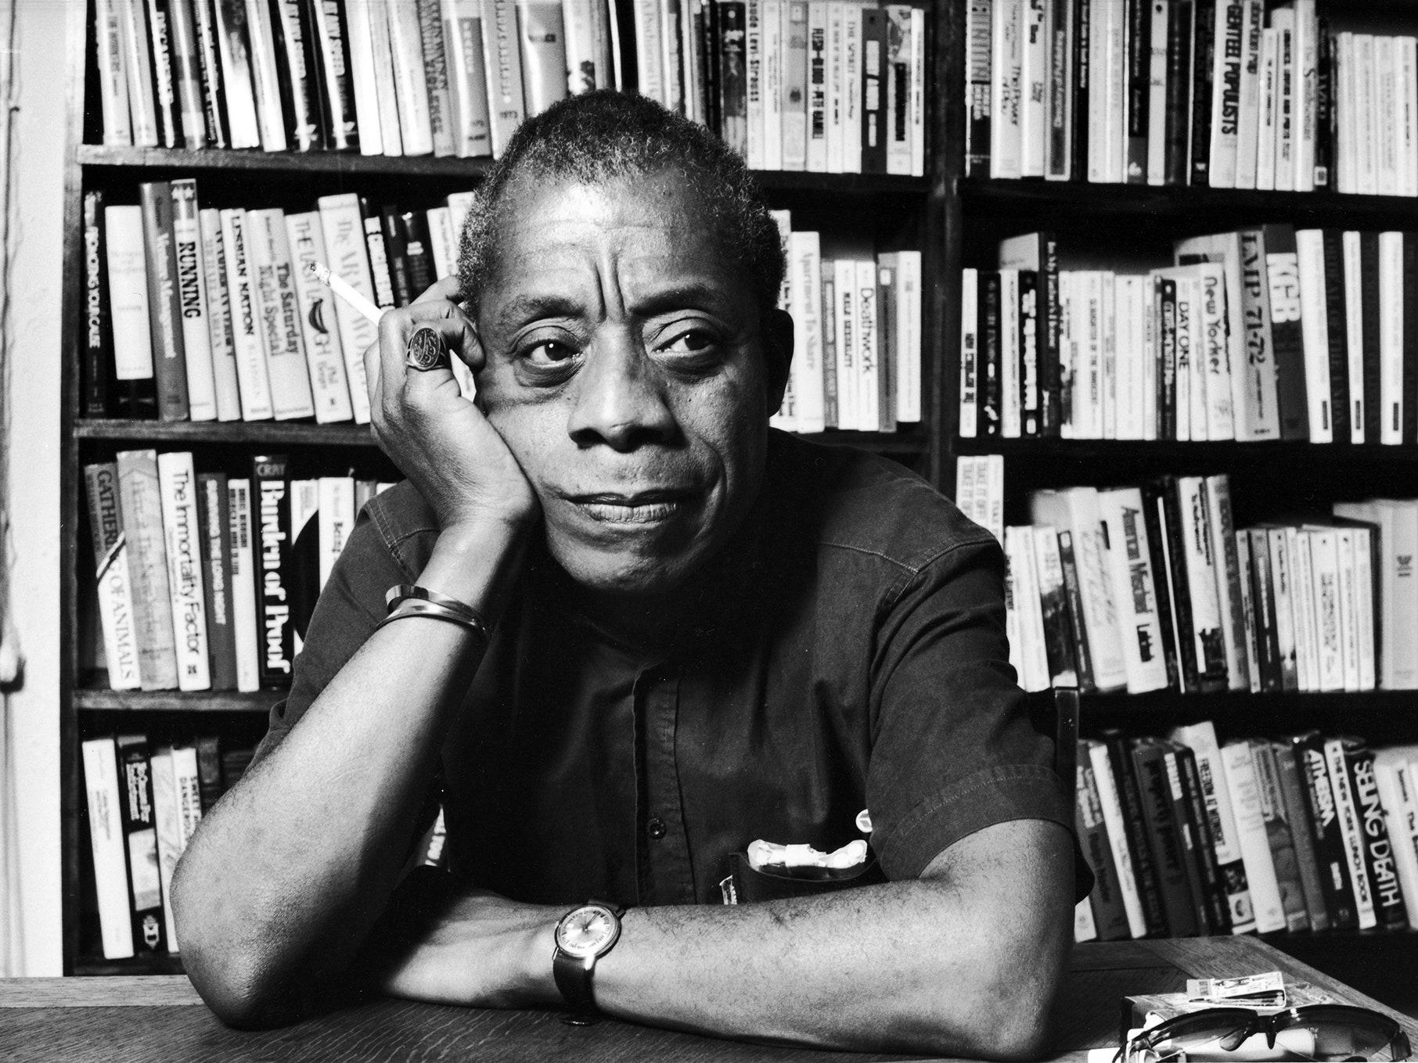
“The children are always ours, every single one of them, all over the globe; and I am beginning to suspect that whoever is incapable of recognizing this may be incapable of morality.”
James Baldwin

Slide 4
Polycrisis

Slide 5
An interconnected web of near simultaneous adversities manifesting interdependently in a globalised world
Polycrisis

Slide 6
Polycrisis
UNICEF (2023)

Slide 7
Problematique

Slide 8
Problematique
Complex set of intertwined, global problems including poverty, inequality, pollution, scarcity, disease, and war

Slide 9
Problematique
Club of Rome (1970)

Slide 10

How does this help/hinder?
Poly-problematique?
Council of despair?

Slide 11
Context is everything
******

Slide 12

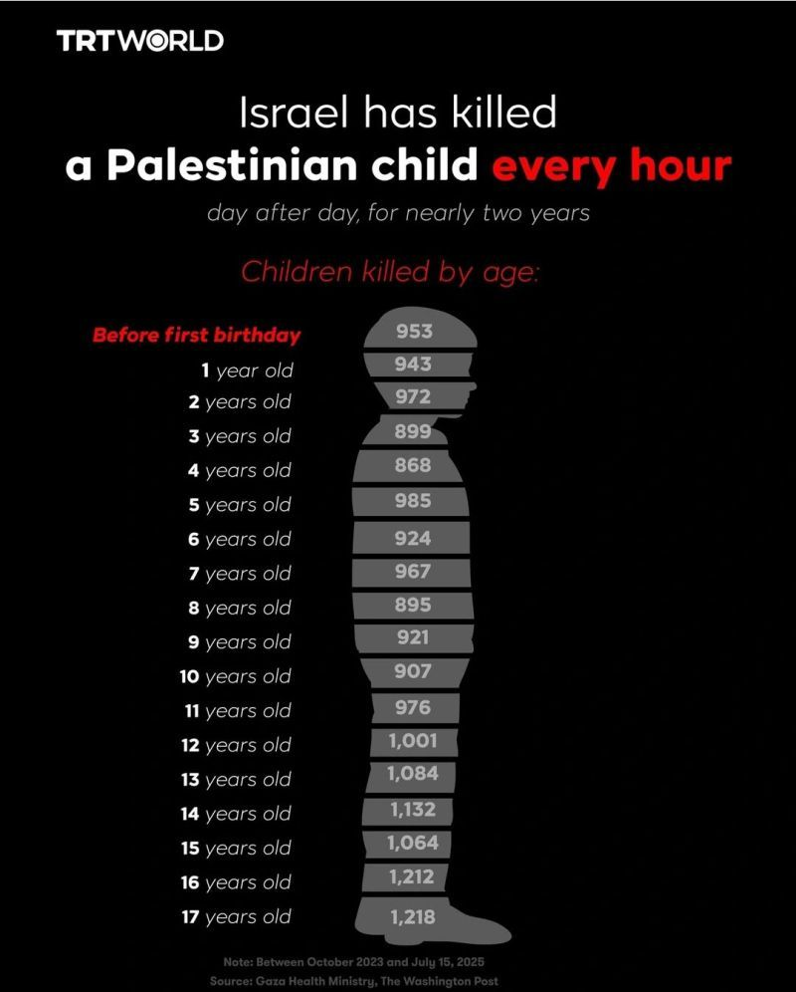
Hind Rajab
29 January 2024

Slide 13

‘Unchilding’ is the authorized eviction of children from childhood
“A foundational premise of ‘unchilding’, is to create, transform, and construct children as dangerous Others
The use of the terrorist label to describe Palestinian children allows for the racial securitization of childhood and incitement of further ‘unchilding’.

Slide 14
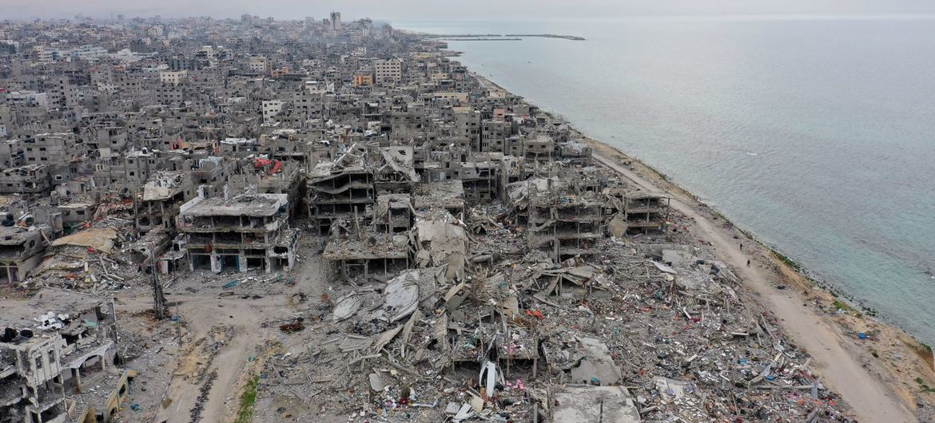
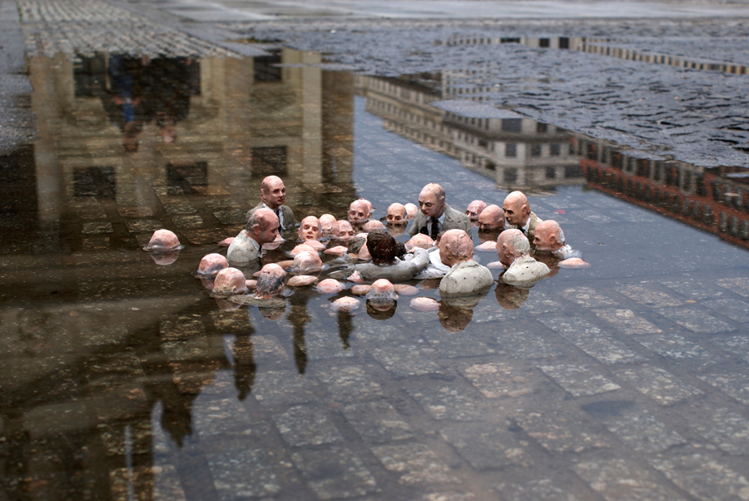
“Sacrifice zones” (Naomi Klein)
******

Slide 15



“The role of the physician is to translate ‘medically unknown symptoms’ into social problems”
Nanna Mik-Meyer
"The first task of the doctor is ... political: the struggle against disease must begin with a war against bad government“
Michel Foucault
picture or icon

Slide 16
Is it either/or for research in a world in crisis
Politics or objectivity
Research or activism

Slide 17

We have much of what we need
picture or icon

Slide 18

*****
******
“Petri dish of the RCT” (Researcher)

Slide 19
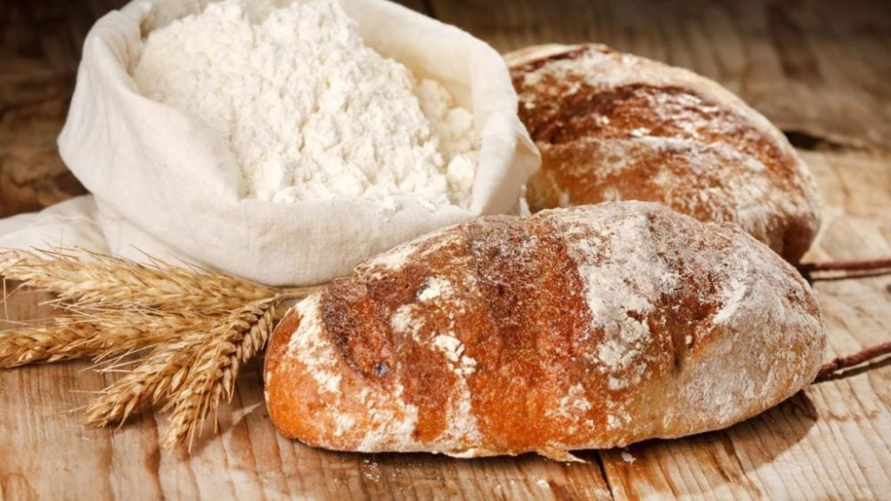
“Putting flour in an oven and expecting bread” (Economist)

Slide 20
And then we change the temperature and the cooking time

Slide 21
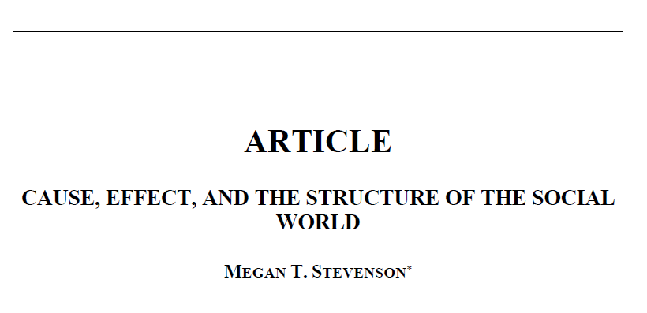
Stabilizers, Cascades and Complexity
Stevenson M. Cause and effect in the social world. Boston Law Review. 2023

Slide 22

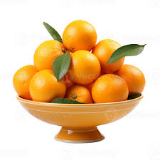
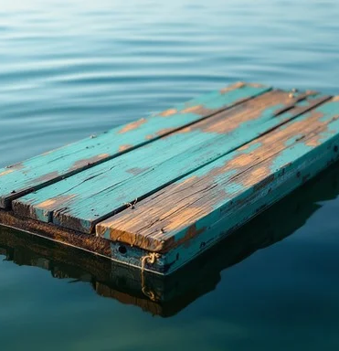
Notes:
Stabilizers are the set of socioeconomic forces that resist externally-imposed change. Imagine an orange in a large bowl. One can push the orange up the side
of the bowl, but as soon as you let go, it rolls back to the bottom.
Consider another analogy: the tides. When the tide is pulling out to sea, the flotsam and jetsam will be carried along with it. A gentle cross breeze might create some eddies but will have little impact on the overall direction of flow. If change is governed by widescale social forces, then the interventions evaluated via RCT might be like this gentle breeze: ultimately irrelevant.

Slide 23
“The social scientists’ holy grail—the small, inexpensive intervention with large, widespread, and lasting gains—appears to be mostly myth.”
(Stevenson, 2023)

Slide 24
Complex systems
We appear unable to think of complex systems
“Cannot hold the level of complexity in our heads and so we become story tellers”
“We turn a vast social tapestry into a single silhouette”
David Eagleman

Slide 25
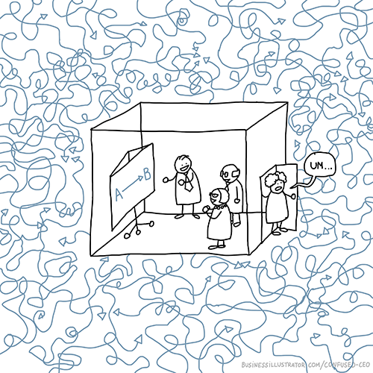
Linear solutions to non-linear problems
picture or icon

Slide 26
What do children in crisis need?
Lessons from critical incident debriefing
What should we be researching?

Slide 27
What do children in crisis need?
Sense of safety
Caregivers able to provide a safe psychic space

Slide 28
Knowledge to action gap gets wider
Less than 10% of 22 000 clinical trials during pandemic were well-designed and well-implemented
90% were not able to contribute to policy recommendations by governments, WHO and other agencies
Fewer than 3% and 5% of trials occur in WHO’s African and Eastern Mediterranean regions
(WHO, 2024; Moorthy et al, 2025)

Slide 29
Caregiver and community engagement
In May 2022, member states of WHO adopted the World Health Assembly WHA75.8
Central to the resolution was the recognition of the central role of community stakeholders in the clinical trial ecosystem.

Slide 30
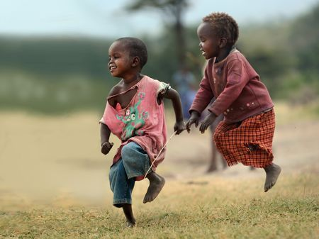
Play is the ultimate expression of freedom for its own sake
David Graeber

Slide 31


‘Pretend play’ - most sophisticated, important and characteristic human abilities
Reading the mind of the other to keep play going (free play)
Emotional regulation
Dealing with the unexpected
Different types of empathy

Slide 32
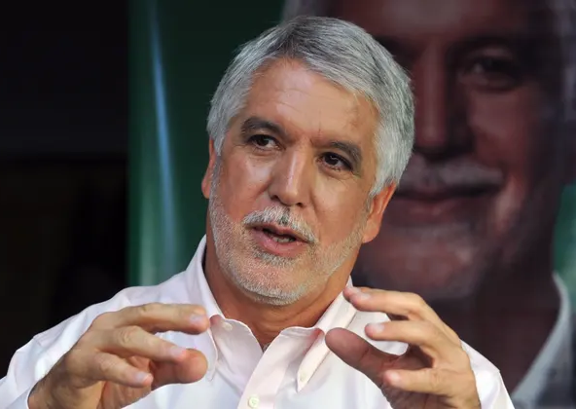
“Children are a kind of indicator species,” “If we can build a successful [society] for children, we will have a successful [society] for all people.”
Enrique Peñalosa
Former mayor of Bogotá
Notes:
This summarises the frame of my current thinking and approach in this presentation
I want system and population level change. Not about moving from one primary care clinic to another primary care clinic
How do we change our economic and social systems to better care for children

Slide 33
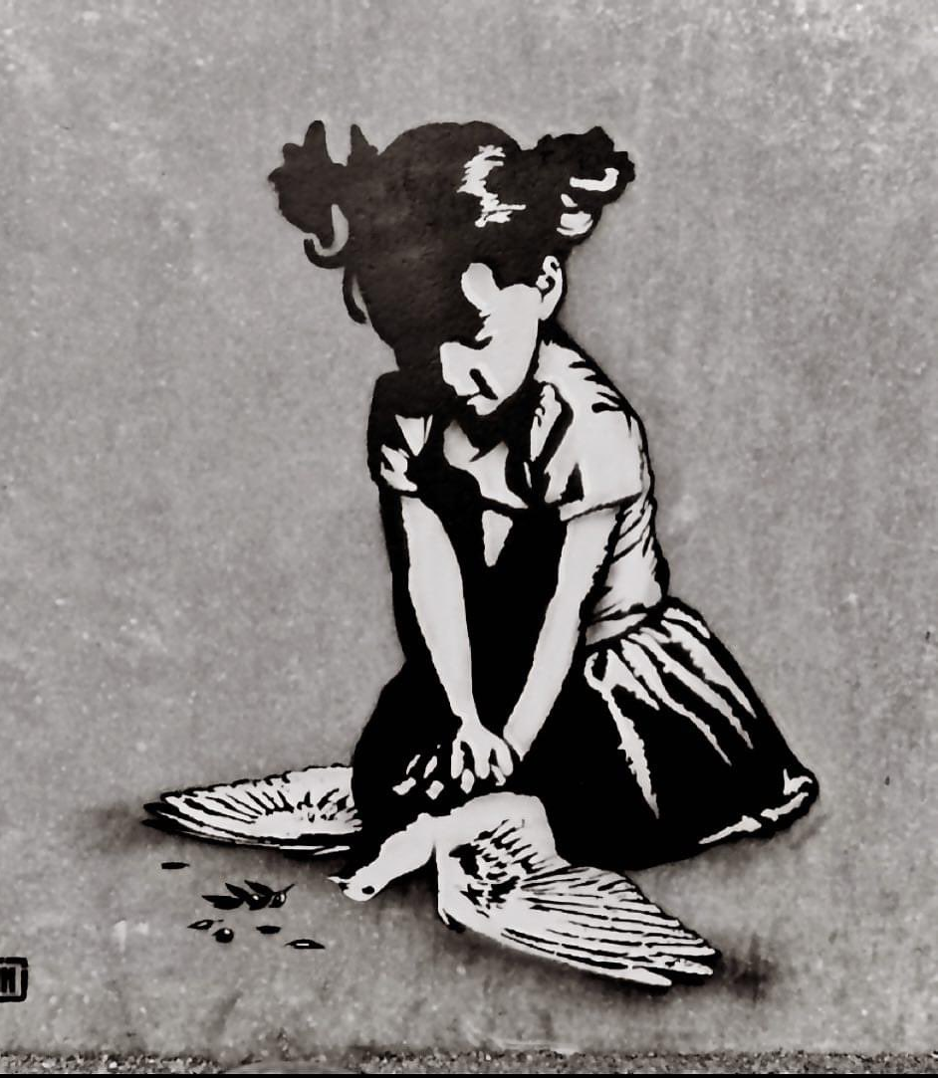
History says, don’t hope On this side of the grave. But then, once in a lifetime The longed-for tidal wave Of justice can rise up, And hope and history rhyme
Seamus Heaney
Goin, Graffiti Artist

Slide 34

THANK YOU!

