Slide 1

Digital Challenges for ECD Research in Crisis:
The Way Forward
NAEL ALAMI, PhD | Modern University for Business & Science, Lebanon
Evidence for Action Symposium | Amman, Jordan, 16 August 2025
Notes:
This talk will unpack the digital challenges of conducting Early Childhood Development (ECD) research in crisis contexts, with a focus on the Arab region, and outline practical ways forward.

Slide 2

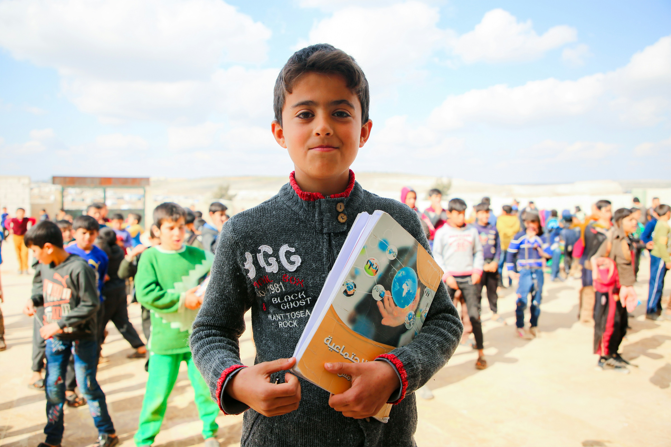
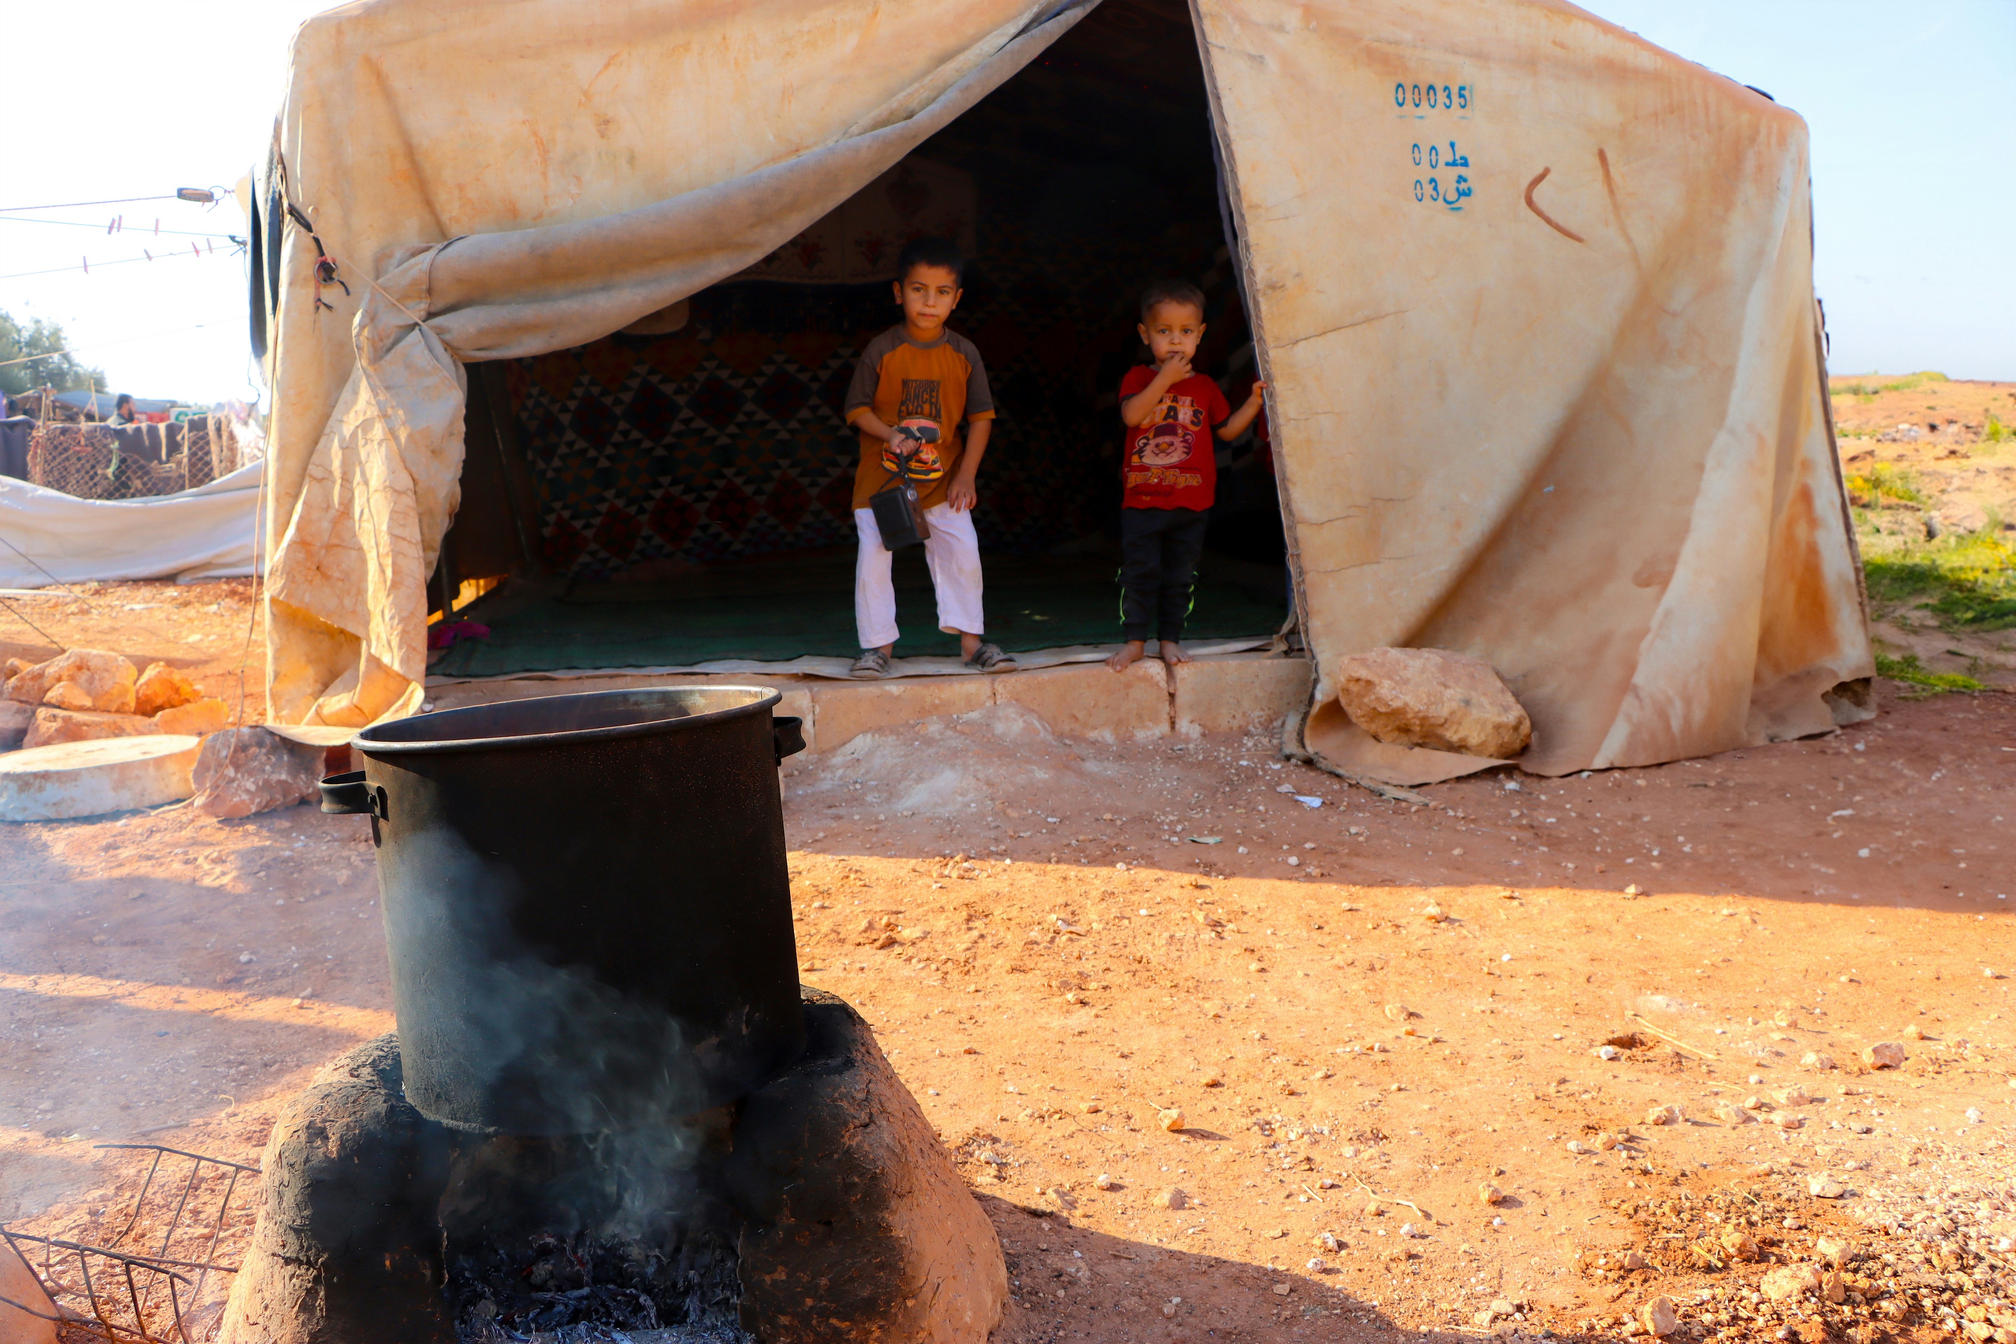
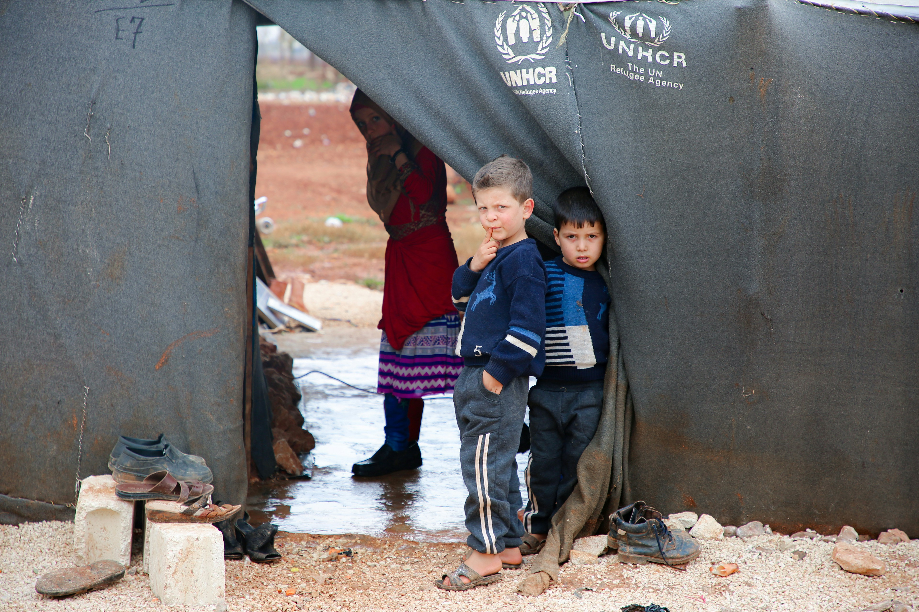

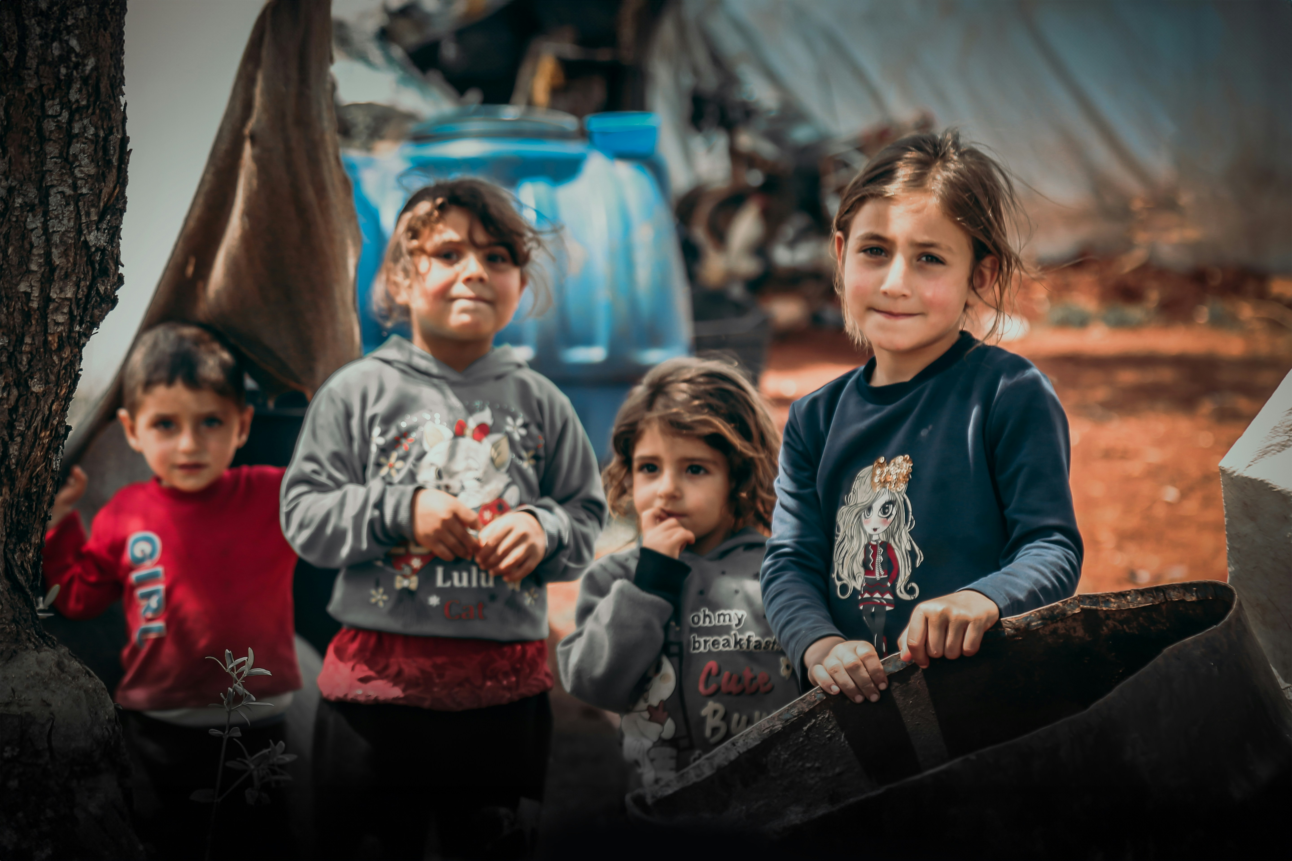
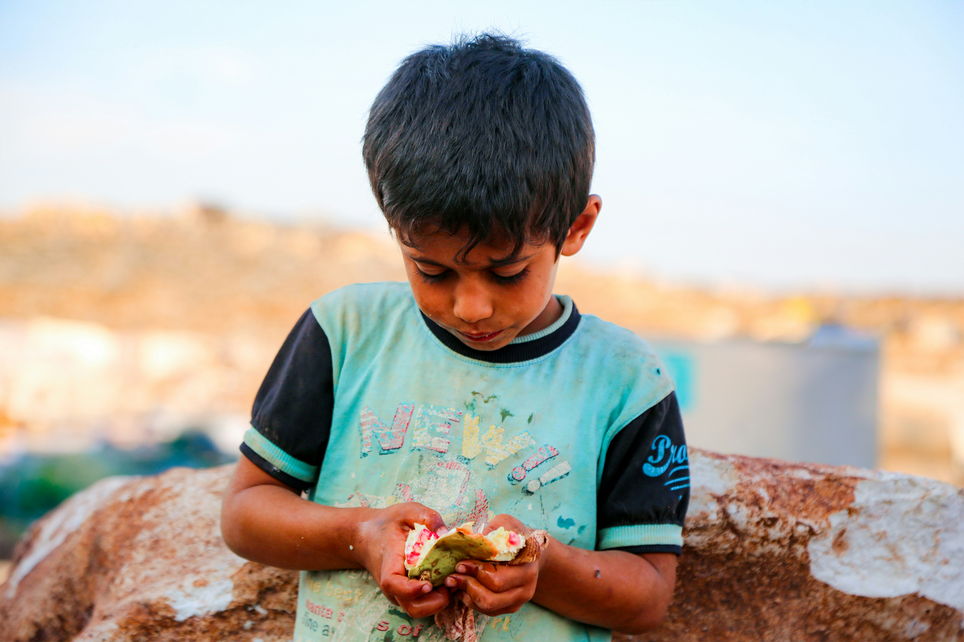


In crisis, what we cannot see, we cannot save.
developmental delays,
trauma,
hunger goes undocumented
Source: Saleh Darwich - Unsplash.com
During Lebanon’s multidimensional crisis, the youngest and most vulnerable, especially those in refugee camps and informal settlements, are systematically excluded from research and policy due to data collection barriers
Notes:
Imagine being four years old, living in a tented settlement on the outskirts of Beirut. You haven’t seen a doctor in over a year, your preschool shut down months ago, and your parents, struggling to survive Lebanon’s economic collapse, can’t afford to feed you three meals a day. Now imagine that, to the outside world, you don’t even exist.
This is the reality for thousands of young children in Lebanon today. A 2023 report by the Arab Network for Early Childhood (ANECD) reveals that during Lebanon’s multidimensional crisis, the youngest and most vulnerable, especially those in refugee camps and informal settlements, are systematically excluded from research and policy due to data collection barriers. Their developmental delays, trauma, and hunger go undocumented, making their needs invisible to decision-makers and donors.

Slide 3
In crisis contexts,
digital gaps are research gaps, and research gaps become policy blind spots.
This is the core challenge of evidence invisibility in ECD crisis research.
Without overcoming digital barriers, we cannot close the gap between research and policy in the Arab region, and underserved children remain unseen.
Notes:
This is the core challenge of evidence invisibility in ECD crisis research. Crises don’t just disrupt services; they reshape childhood itself. When we move research into digital spaces, we gain reach but risk losing the very children who most need to be seen.
Without overcoming digital barriers, we cannot close the gap between research and policy in the Arab region, and underserved children remain unseen.

Slide 4
Why Digital ECD Research in Crises is Different
Volatile Access: unstable electricity, costly data (UNICEF, 2023).
Ecology of Stress: displacement, caregiver burden (Brookings, 2023).
Ethics at the Edge: higher safeguarding risks (UNCRC GC25, 2021).
System Fragmentation: incompatible data standards (ESCWA, 2024).
Notes:
Drawing from global research and MENA signals:
Volatile access: Electricity, devices, and bandwidth fluctuate; airtime costs can derail fieldwork.
Ecology of stress: Displacement, caregiver burden, and household crowding affect participation and child performance on tasks.
Ethics at the edge: Duty-of-care, consent, and safeguarding risks escalate in fragile settings.
System fragmentation: Multiple, siloed platforms with incompatible data standards block regional synthesis.
These conditions make crisis-context digital research fundamentally different from standard settings. Tools and protocols can’t just be copied from stable environments.

Slide 5

Access Gaps Leave Millions of Children Invisible
Challenge | Data | Response
Limited devices and internet | Only 14% of children in Africa have reliable internet (UNICEF/UNESCO, 2024) | Multimodal stack: SMS, USSD, IVR, WhatsApp, radio
Gender barriers | Women/girls often lack personal devices in conservative/displaced communities | Community Wi-Fi hubs, airtime/device subsidies
Notes:
A. Access and Equity
Households without smartphones, women with restricted phone access, and displaced families are underrepresented.
In 2023, only 14% of children in Africa had reliable internet access (UNICEF/UNESCO 2024); MENA rural–urban disparities mirror this (UNESCO, 2022).
Gender norms further restrict access: women and girls in conservative or displaced communities often lack personal device access, limiting caregiver participation in digital surveys and child assessments.
Response: Multimodal stack (SMS/USSD, IVR, WhatsApp, radio) + offline kits, community Wi-Fi hubs, airtime/device subsidies.

Slide 6

Remote Measures Risk Losing Accuracy
Key Issue
Response
Socio-emotional and interaction measures degrade remotely (Brookings, 2023)
Bias: noise, caregiver prompting
Cross-validate
Use short audio-first tasks
Add attention checks
Notes:
B. Measurement Validity
Socio-emotional and interaction measures degrade remotely; home noise and caregiver prompting bias results (Brookings, 2023).
Response: Cross-validate remote vs. in-person tools, use short audio-first tasks, add attention checks, and publish psychometric results.

Slide 7
Protecting Children’s Data is Protecting Their Safety
Risks
Solutions
Sensitive data over consumer apps in high-risk zones (UNCRC General Comment No. 25, 2021)
Trauma-informed consent in plain Arabic
End-to-end encryption and local hosting
Align with GDPR and UNCRC GC25
Notes:
C. Safeguarding, Consent and Data Protection
Sensitive data travels over consumer apps with limited security in high-risk contexts (UNCRC General Comment No. 25, 2021).
Response: Trauma-informed consent in plain Arabic, encryption end-to-end, local hosting where feasible, and GDPR/UNCRC GC25–aligned governance.

Slide 8
Without Skills and Coordination, Digital Tools Fail
Problems
Solutions
Limited ICT skills among field staff
Siloed humanitarian data systems
Just-in-time modular training + mentorship
Common data dictionaries and APIs for interoperability
Notes:
D. Practitioner Capacity and Coordination
Many field staff lack ICT and ethics training for remote tools.
Standardized Rapid Monitoring (SRM) findings are rarely linked to humanitarian platforms like UNHCR’s PRIMES or OCHA’s HDX.
Response: Modular, just-in-time training + mentorship; common data dictionaries and APIs for interoperability.

Slide 9

Arab Region in Focus
1- 71M children under 5 globally in conflict (UNICEF, 2024)
2- 40% of Arab States’ children lack preschool access (UNESCO, 2024)
3- Device access disparity: e.g., Lebanon 38% (UNESCWA, 2024)
Notes:
The Arab region faces a unique convergence of crises—armed conflict, displacement, economic collapse, and climate stress—that disproportionately affect young children. As of 2024, over 71 million children under age five globally have never known life outside conflict, with a significant concentration in the Middle East and North Africa (MENA). In countries like Syria, Yemen, Lebanon, and Palestine, early childhood development (ECD) systems are fragmented, underfunded, and digitally under-resourced.
The UNESCO-UNICEF Global ECCE Report (2024) highlights that 40% of children in the Arab States do not attend any organized learning before primary school. This gap is exacerbated by digital divides, especially in rural and refugee-hosting areas, where internet access and device availability remain low.
The ITU Arab Digital Development Report (2025) reveals persistent disparities in digital infrastructure across Arab countries. While urban centers in Gulf states show high connectivity, fragile states like Yemen, Syria, and Sudan lag significantly. In Lebanon, for example, only 38% of households with children under five have consistent access to digital devices suitable for learning or research.

Slide 10
Regional Realities
Country | Key Challenges | Adaptation/Outcome
Lebanon | Low device access, high caregiver stress | Hybrid tracking w/ airtime stipends (UNICEF, 2024)
Jordan | Policy-driven digitization | 5,000+ workforce trained, QA and licensing digitized
Yemen | Infrastructure collapse | Offline-first design, community intermediaries
Notes:
Lebanon – Crisis disrupts families, services, and research; caregiver stress and rising screen-time concerns underscore the need for low-cost, Arabic-localized, privacy-conscious approaches (UNESCO, 2022).
Pilot: UNICEF Lebanon’s hybrid ECD digital tracking showed real-time nutrition monitoring worked—only with airtime stipends and localized interfaces (UNICEF Lebanon, 2024).
Jordan – Policy momentum on digitization in ECD: digitized nursery licensing, monitoring systems, workforce scaling (5,000+ trained workers), QA systems, and early-intervention units provide infrastructure for integrating digital research into practice.
Yemen – Paper-based registries remain the norm; conflict and infrastructure collapse limit digital feasibility, requiring offline-first design and community intermediaries (UNESCO YEMIS, 2022).

Slide 11
Regional Realities
Country | Innovation | Lesson
Palestine | WhatsApp parenting and early learning | Offline-first, audio tools critical
Iraq | Digital milestone tracking in preschools | Needs infrastructure and workforce investment
Morocco | Mobile preschool inspection app | Mobile units for rural outreach
Sudan | USSD and IVR for nutrition/stress monitoring | Low-tech works in fragile states
Notes:
1. Palestine:
ECD services in Gaza and the West Bank face severe disruptions due to political instability and infrastructure damage. A 2023 study by Save the Children found that over 80% of children reported living in constant fear, with 59% of caregivers observing regression in children’s speech, behavior, and emotional regulation. The blockade and repeated escalations have led to chronic stress and trauma, with limited access to mental health and early learning services.
Digital Response: NGOs piloted WhatsApp-based parenting support and early learning modules. However, low smartphone penetration, electricity outages, caregivers' stress, and digital illiteracy limited reach.
Lesson: Offline-first, audio-based tools and low-tech, and community-based digital ECD strategies.
2. Iraq: Post-Conflict ECD Recovery and Digital Integration
Following years of conflict, Iraq’s Ministry of Education partnered with UNICEF to digitize early learning assessments in 2023. The Iraq ECD Digital Pilot used tablets in urban preschools to track developmental milestones.
Findings: Urban centers showed promise, but rural areas lacked connectivity and trained staff.
Lesson: Digital ECD must be paired with infrastructure investment and workforce development.
3. Morocco: Bridging Urban-Rural Digital Divide
Morocco’s national ECD strategy includes digital monitoring of preschool quality. In 2024, the government launched a mobile app for preschool inspections, enabling real-time data collection.
Challenge: Rural preschools lacked devices and digital literacy.
Solution: The Ministry deployed mobile inspection units with trained staff and offline data sync capabilities.
4. Sudan: Crisis-Driven Innovation in ECD Monitoring
Despite ongoing conflict, Sudanese NGOs have used feature-phone-based surveys (USSD and IVR) to monitor child nutrition and caregiver stress in IDP camps.
Impact: Enabled data collection from disconnected populations.
Lesson: Low-tech solutions are critical in fragile states.

Slide 12
Innovation is Happening Despite the Odds
Ahlan Simsim
ANECD SRM Pilot
Arab Digital Agenda
2023-2033
Notes:
Despite challenges, several regional initiatives offer scalable models:
Ahlan Simsim, a partnership between Sesame Workshop and the International Rescue Committee, has reached over 3 million children and caregivers in Iraq, Jordan, Lebanon, and Syria through hybrid digital and community-based ECD programming. Their remote early learning adaptations during COVID-19 demonstrated the feasibility of digital tools in crisis zones when paired with localized content and caregiver support.
The Arab Network for Early Childhood (ANECD) has piloted Standardized Rapid Monitoring (SRM) tools across Lebanon and Jordan, revealing that digital survey tools failed in refugee camps without connectivity and digital literacy training. The findings underscore the need for offline-first designs, Arabic-localized interfaces, and community intermediaries.
The Arab Digital Agenda 2023–2033, led by UN-ESCWA, calls for regional harmonization of digital policies, including child data protection and interoperability standards for humanitarian and education platforms.

Slide 13
Implementation Playbook
Methods and Measurement: hybrid tools, offline enrollment, zero-rated data
Ethics and Stewardship: dynamic consent, anonymization, duty-of-care protocols
Operations and Enablement: budgeting for true costs, Arabic-first design, capacity building
Notes:
Methods and Measurement
Core tools: caregiver phone surveys, audio-based child language tasks, micro-video observation only when feasible.
Sampling: combine offline enrollment, community referrals, quotas for no-device households; track noncoverage.
Strengthening Digital Infrastructure: Invest in low-bandwidth tools like KoboToolbox and SurveyCTO offline modes; partner with telecoms for zero-rated data access to enable free data uploads from crisis zones.
Ethics and Stewardship
Dynamic, iterative consent; minimize sensitive data.
Duty-of-care protocols pre-mapped to referral partners.
Data retention limits; anonymization; secure hosting.
Ethical and Secure Data Governance: Develop regional child data protection frameworks inspired by GDPR (General Data Protection Regulation) and UNCRC GC25; Use anonymized, encrypted databases to protect sensitive child data.
Operations and Enablement
Budget for true costs: devices, airtime, training, security.
Arabic-first design, dialect sensitivity, co-created with communities.
Capacity Building: Train enumerators, caregivers, and researchers in digital literacy and ethical data collection; Embed ECD crisis modules in university curricula and humanitarian training programs.

Slide 14

Turning Evidence into Policy and Action
Policymakers
Researchers
Integrate digital ECD into crisis frameworks
Mandate interoperability
Validate tools
Prioritize disconnected households
Donors
Regional Collaborations
Fund infrastructure
Support regional governance bodies
Arab ECD Digital Research Hub
Global Digital Compact and MMA
Notes:
For policymakers:
Integrate digital ECD research strategies into national crisis response frameworks.
Mandate interoperable data standards across ministries and humanitarian partners.
For researchers:
Validate remote tools in crisis contexts; publish results openly.
Prioritize inclusion of marginalized, disconnected households in sampling frames.
For donors:
Fund long-term digital infrastructure, not just short project cycles.
Support regional data governance bodies for ECD in crisis.
Regional Data Collaboration
Launch an Arab Regional ECD Digital Research Hub to centralize datasets, enable cross-country comparisons, and support policy access (ANECD, 2024).
Link with Global Digital Compact and Moving Minds Alliance platforms to align with global standards.

Slide 15
We cannot improve what we cannot see…
What will it take to make every child visible?
Notes:
We cannot improve what we cannot see, and in crisis, what we cannot see, we cannot save.
Arab region faces complex crises affecting ECD.
Digital tools can work, but equity, offline capabilities, and localization are key.
Collaboration and governance are essential for scaling digital ECD research.
Contribute to the collaborative effort to make every child in crisis visible in our data, our policies, and our future.

Slide 16
References
ANECD. (2023). Lebanon ECD Situational Assessment. Lebanon ECD Situational Assessment Study - ANECD Arab Network for Early childhood
ANECD. (2024). Annual Report 2022–2023. ANECD Report
Brookings Institution. (2023). Early Childhood Development at CUE. Brookings Collection
ESCWA. (2024). Arab Digital Development Report. Arab Sustainable Development Report 2024 - United Nations Economic and Social Commission for Western Asia
KoboToolbox. (2025). Collecting Data Offline. KoboToolbox Documentation
Moving Minds Alliance. (2024). Annual Report. MMA Bulletin
SurveyCTO. (2025). Offline Data Collection. SurveyCTO Docs
UN. (2024). Global Digital Compact. UN Digital Compact
UNCRC. (2021). General Comment No. 25 on Children’s Rights in the Digital Environment. OHCHR Document
Save the Children. Trapped: The impact of 15 years of blockade on the mental health of Gaza’s children. Trapped: The impact of 15 years of blockade on the mental health of Gaza's children - Save the Children’s Resource Centre
UNICEF Iraq. Iraq launches, with the support of UNICEF, the National Strategy on Early Childhood Development. May 2022. Iraq launches, with the support of UNICEF, the National Strategy on Early Childhood Development.
UNESCO. Advancing Preschool Education in Morocco: Goals for Inclusion, Quality, and Sustainable Governance. 2024. Advancing Preschool Education in Morocco: Goals for Inclusion, Quality, and Sustainable Governance - Early childhood care and education
UNHCR. Regional Child Protection Brief – Sudan Situation. June 2024. https://data.unhcr.org/en/documents/download/110032
UNESCWA. Arab Digital Development Report 2022: Towards Empowerment and Inclusion for All. December 2024. Arab Digital Development Report 2022: Towards Empowerment and Inclusion for All - United Nations Economic and Social Commission for Western Asia
UNESCO & UNICEF. (2024). Global Report on Early Childhood Care and Education. UNICEF Report
UNESCO. (2022). YEMIS Policy Guidelines. YEMIS Publication
UNICEF Lebanon. (2024). Nutrition and Child Development Programme. UNICEF Lebanon
IRC. Transforming Tomorrow: Innovative Solutions for Children in Crisis. Report 2024. Transforming Tomorrow: Innovative Solutions for Children in Crisis
ITU. State of digital development and trends in the Arab States region: Challenges and opportunities. 2025. State of digital development and trends in the Arab States region: Challenges and opportunities - ITU

Slide 17


THANK YOU!

