Slide 1


Reflections
Joan Lombardi, PhD
August 17, 2025

Slide 2

Thank you Dr. Ghassan and the Arab Network for Early Childhood and The Moving Minds Alliance

Slide 3

Thank you to The National Council for Family Affairs in Jordan And all of you who are here learning and sharing

Slide 4

Research and the Moving Minds Alliance
The groundbreaking implications of the Strategic Research Model
The New Ecology of Child Development

Slide 5
Research, Rights and Regional Action

Slide 6

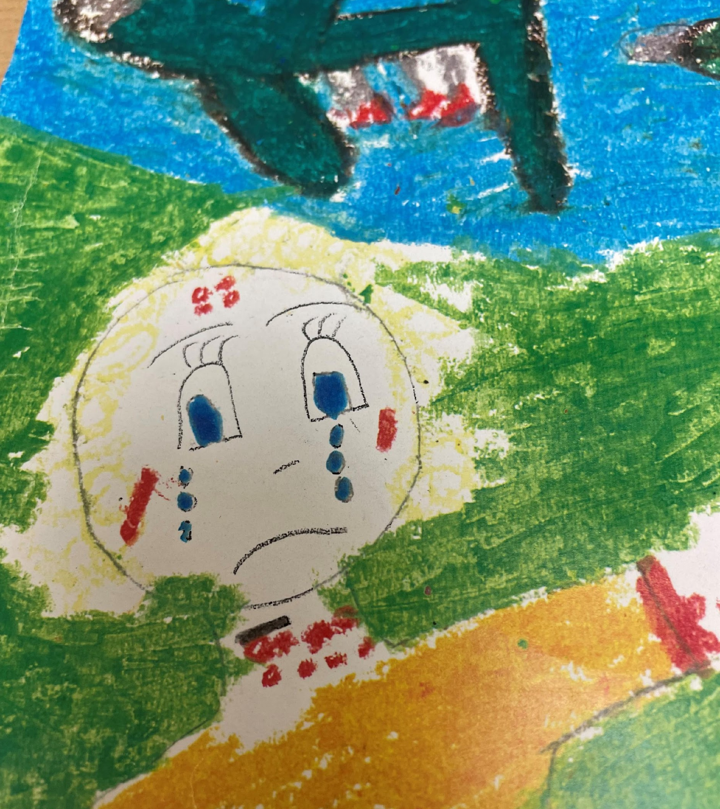
General comment 7 of the CRC
General comment 7 emphasizes that young children are rights holders
In the context of war, this means ensuring young children’s protection, access to basic needs and opportunities for development during conflicts

Slide 7
The Moving Minds Alliance and Research: A journey in transition
2017 Funders came together to shine a spotlight on young children in emergencies-Moving Minds Alliance
Emerging focus on research-Very little data or focus on young children, for example most humanitarian response plans did not focus on young children, data on children in emergencies not disaggregated, difficult doing research in conflict situation and little understanding of challenges
2022-2024 MMA Research Forum on Children and Emergencies
Evidence based review, expert advisory from around the world, webinars and pilot of research fellows
2024- decentralize to put more focus on global south, continue fellows, lift up the research efforts of Arab Network on Early Childhood
2025- Research director, BRAC assumes fellows, ANEC research meeting (today!)

Slide 8
The Strategic Research Model- groundbreaking innovation in research
Collaborative across countries- sharing and learning
Capacity building of researchers at the national level
Flexible on methodology
Cultural context valued
Caregiver voice essential
Empowering action
Timeliness
Can help inform Practice, Parents, Policy

Slide 9

Next steps
Continue to build out the SRM and share with other countries
Be more proactive in working with policymakers. Ask them what do they need?
Have a communication plan

Slide 10
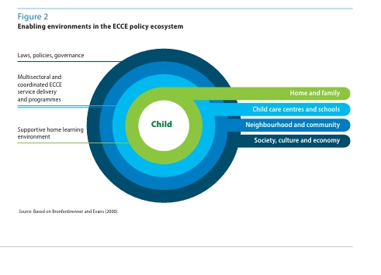
The New Ecology of Child Development: International Perspective
Persistent poverty and inequality
Urbanization
Climate change
Conflict
Displacement
Technology
Figure from UNESCO, Global Report on Care and Education,
The Right to a Strong Foundation, 2024

Slide 11


Thinking across the life course
Prenatal -
age 3
3- school entry
Early School age
Notes:
Coming to terms- forgive me
Nomenclature varies – conceps stayed pretty consistent
One period builds on another- continuity
What is early childhood- kdomestic and global view
Less attention at the tow ends
Frame- children vs families, long tradition seeing the interactions

Slide 12


Slide 13
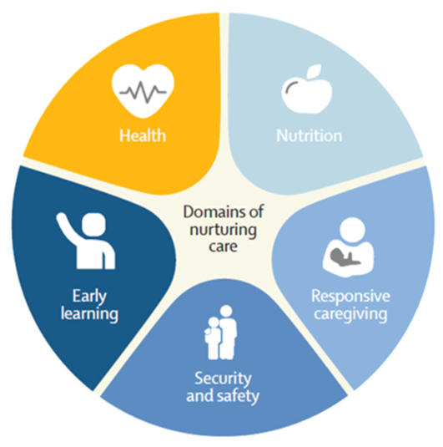
Enabling policies
Empowered communities
Supportive services
Caregivers’ capabilities

Slide 14


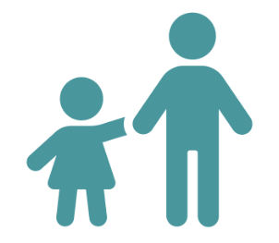
Dual generation programs
EARLY LEARNING OPPORTUNITIES
LIVELIHOOD OPPORTUNITIES
DUAL-GEN OUTCOMES
RESPONSIVE CARE
SOCIAL CAPITAL
GOOD HEALTH & ADEQUATE NUTRITION
SAFETY AND SECURITY
Adapted from The Nurturing Care Framework
Developed by Children in Crossfire, Busara, Global Schools Forum

Slide 15
THE KEY COMPONENTS OF AN EARLY CHILDHOOD ECOSYSTEM WHICH PROMOTE CHILD DEVELOPMENT
Family Social and Economic Support
Health, Nutrition,
Mental Health
Early Care and Education
Neighborhood Conditions

Slide 16


